Slide 1
Durga mahavidyalaya Department of commerce Dr vaseemuddin management accounting Topic-types of ratio

Slide 4
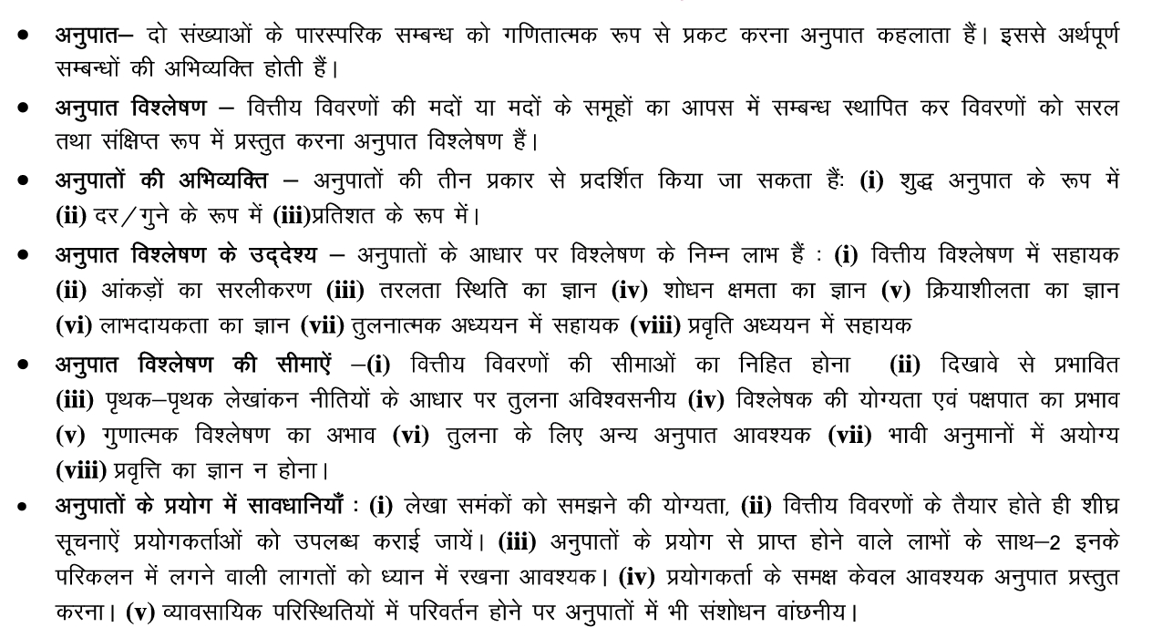

Slide 6
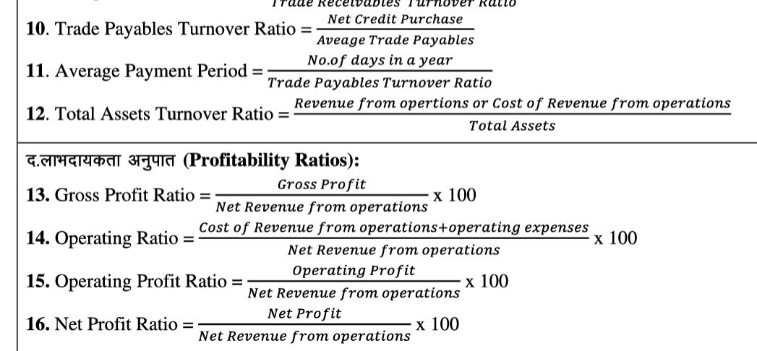

Slide 7
Thank you

